Slide 1
Infosys Springboard
Personal Experience & Contribution
Infosys Springboard Internship
Election Analytics Project (ElectViz)
Hamiz · Team Leader
1

Slide 2
About Me
▸ Aspiring data analyst - Power BI, Excel, Python, SQL
▸ Undergraduate in Computer Science / IT
▸ Joined Infosys Springboard for real-world project exposure
▸ Motivated by large-scale election data analytics
▸ Passionate about converting raw data into visual insights
▸ Eager to apply analytics in public-interest domains
H
Infosys Springboard · Election Analytics (ElectViz)
2

Slide 3
Overview of My Role in the Project
▸ Team Leader - coordinated tasks, timelines & deliverables
▸ Led dataset merging across 36 states into unified master CSV
▸ Maintained project GitHub repo (version control, branches)
▸ Designed end-to-end architecture flow for data pipeline
▸ Built M3 dashboards - Real-Time Results & Analytics views
▸ Bridge between team and project mentors
Leadership
▸ Task coordination
▸ Timeline management
▸ Mentor sync
Technical
▸ Dataset merging
▸ GitHub repo owner
▸ Dashboard builder
Infosys Springboard · Election Analytics (ElectViz)
3

Slide 4
Technical Skills Gained
Data Cleaning
Power BI
Dataset Architecture
▸ Null handling
▸ Dashboard design
▸ Star schema models
▸ Duplicate removal
▸ DAX basics
▸ 36-state integration
▸ Type casting
▸ Slicers & KPIs
▸ Schema design
These skills were gained hands-on through Milestone tasks, not just theory.
Infosys Springboard · Election Analytics (ElectViz)
4

Slide 5
Tools & Technologies I Used
Power BI
Excel
GitHub
Data Collection & Integration
Dashboard creation, visualizations & reports
Data cleaning, preliminary analysis
Version control, collaboration
Gathered election data from official online sources and unified it through structured cleaning and merging.
Key Techniques
▸ Dataset merging (36 state-level files)
▸ Data standardization (14-column schema)
▸ Party name normalization
▸ Format consistency enforcement
Infosys Springboard · Election Analytics (ElectViz)
5

Slide 6
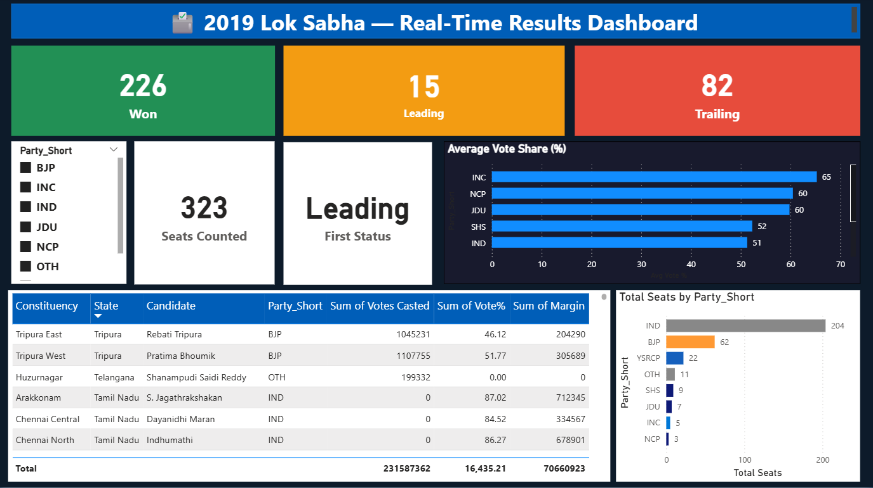
My Milestone Dashboard (M3)
Infosys Springboard
● Real-Time Results Dashboard for election night
● Live vote tallies, leading candidates & party standings
● Helps Media make data-backed calls quickly
● Slicers: State, Party, Constituency filtering
● Key: seat projections, vote share, swing analysis
Built in Power BI · Milestone M3 deliverable
Infosys Springboard Internship · ElectViz Project · Hamiz
6

Slide 7
Challenges & How I Solved Them
Incomplete Datasets
Solution: Filled gaps using cross-referencing with ECI & alternative sources
Format Inconsistencies
Solution: Standardized all data into a uniform 14-column schema
Large-Volume Merging
Solution: Automated merging scripts; validated row-count integrity
Timeline Management
Solution: Set milestones, tracked progress, resolved blockers early
Infosys Springboard · Election Analytics (ElectViz)
7

Slide 8
Team Collaboration & Leadership Experience
Work Division & Communication
Key Takeaways
▸ Divided work by state regions across team members
▸ Clear communication prevents rework
▸ Used GitHub for code/data collaboration
▸ Consistent standards save integration time
▸ Regular sync-ups to track progress & resolve issues
▸ Leading by example builds team trust
▸ Ensured consistent column naming & data types
▸ Delegation is a skill — not just task assignment
Leadership Experience
▸ Stepped into the TL role - learned to balance doing vs. delegating
▸ Gained confidence in decision-making under tight deadlines
▸ Built a collaborative team culture where everyone felt heard
Infosys Springboard · Election Analytics (ElectViz)
8

Slide 9
My Key Learnings
Technical
Professional
Personal Growth
▸ Power BI dashboard design
▸ Clear communication
▸ Confidence in leading a team
▸ Star schema data modeling
▸ Project planning & milestones
▸ Problem-solving under pressure
▸ Dataset architecture at scale
▸ Stakeholder management
▸ Adaptability to new tools
▸ DAX formulas & KPIs
▸ Documentation practices
▸ Self-discipline & ownership
▸ Data cleaning best practices
▸ Team leadership
▸ Growth mindset
Infosys Springboard · Election Analytics (ElectViz)
9

Slide 10
Conclusion
▸ Transformative learning experience - technical depth + real-world project management
▸ Hands-on with India's election data across 36 states & 1000s of constituencies
▸ Grew as a data analyst, communicator, and team leader
▸ Skills & confidence gained will directly shape my career ahead
Grateful to my mentor and the Infosys Springboard team for their guidance and support throughout this journey.
Hamiz · Team Leader · Infosys Springboard Internship · ElectViz
10

